Slide 1

A Bayesian Workflow Approach to John Snow’s Cholera Data

Slide 2
Outline:
Data wrangling, analysis context and descriptive mapping (slides 3 -7)
Statistical model, scientific question and hypothesis (slides 8 – 12)
Bayesian workflow, assessment and interpretation of results (slides 11 – 20)
Conclusion (slide 21)

Slide 3
John Snow Original Map

Slide 4
Current Map of Soho

Slide 5
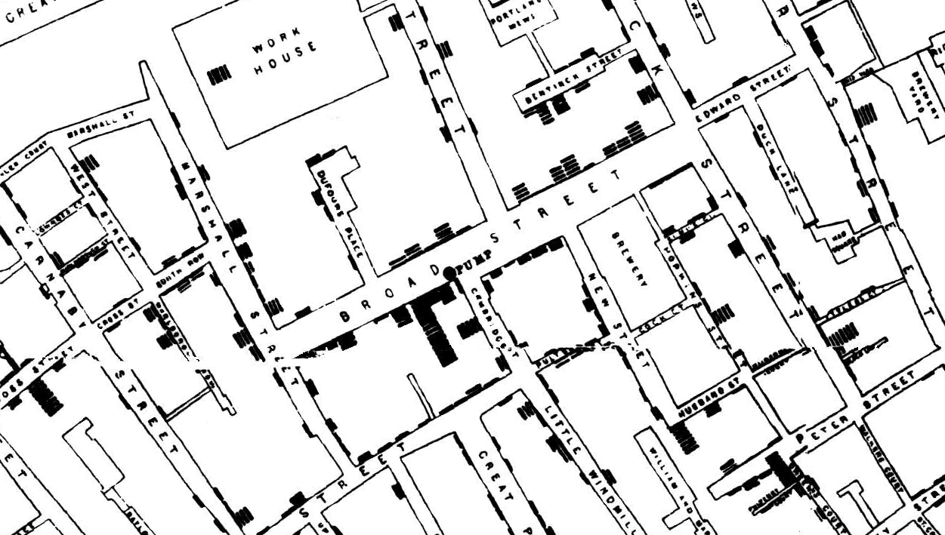


“Snow later used a dot map to illustrate the cluster of cholera cases around the pump. He also used statistics to illustrate the connection between the quality of the water source and cholera cases. He showed that homes supplied by the Southwark and Vauxhall Waterworks Company, which was taking water from sewage-polluted sections of the Thames, had a cholera rate fourteen times that of those supplied by Lambeth Waterworks Company, which obtained water from the upriver, cleaner Seething Wells…” (https://en.wikipedia.org/wiki/John_Snow).

Slide 6
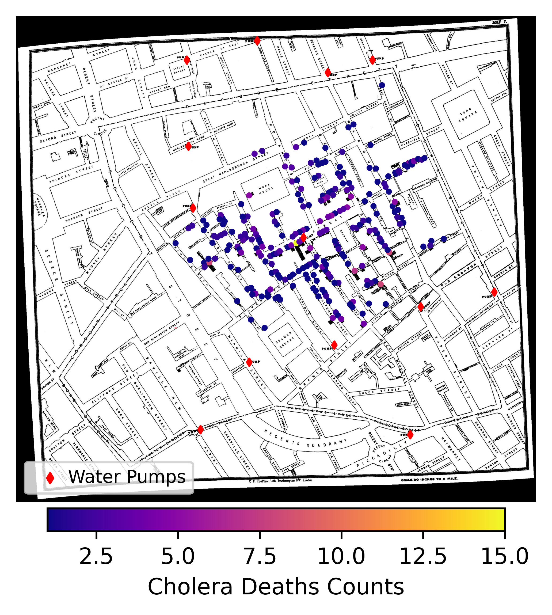
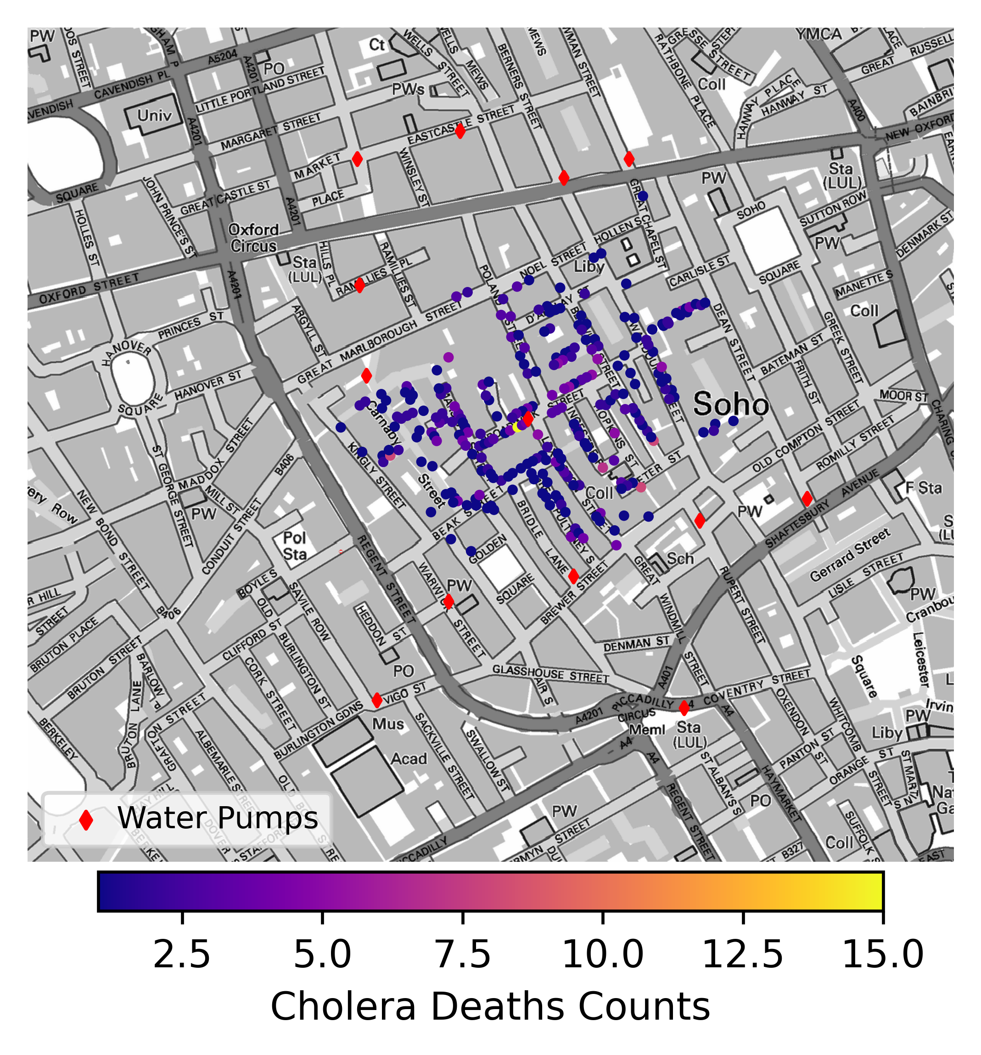

Slide 7
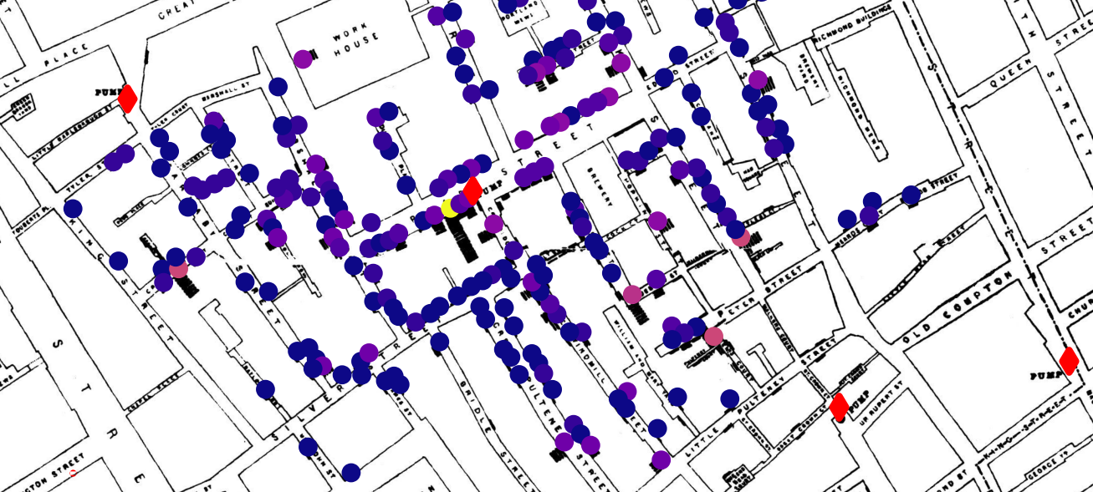
Zooming again into the Broad Street pump, which was contaminated with Cholera. Important responsible for the outbreak on this area.

Slide 8

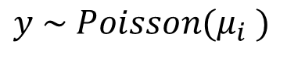

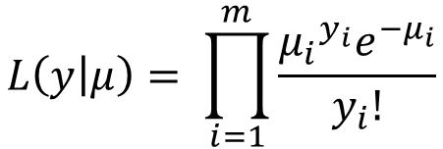
To model count data we can use a Poisson model, which consists of a Poisson sampling distribution (likelihood) with a mean parameter.
$$y \sim Poisson(μ_{i} )$$
Here $μ_{i}$ is the mean over $i$… $m$ locations, each of these locations will have some counts. The Poisson distribution, the likelihood from above, looks like this:
$$L\left(y | μ\right)= \prod_{i=1}^{m}{\frac{{μ_{i}}^{y_{i}}e^{−μ_{i}}}{y_{i}!}}$$
Assuming a fixed expected rate, we can consider $μ_{i}$ to be the exponentiated form of a log-scale parameter $λ_{i}$. We call $λ_{i}$ the intensity and $μ_{i}$ the rate, such that $μ_{i}$ = $e^{λ_{i}}$ .
For a more technical explanation see: Lawson, A. B. (2008). Bayesian Disease Mapping. CRC Press. For further explanation and implementation in R and Stan see: McElreath, R. (2020). Statistical Rethinking: A Bayesian Course with Examples in R and Stan (2nd ed.). Chapman and Hall/CRC.

Slide 9
Given the previous approach, we can estimate the intensity of a fixed rate process or event given that we have observed counts as input.
Counts could be, in principle, anything that can be observed at a specific location, such as number of deaths, outbreaks, infected people, etc.
It is even possible to work with single occurrences, such as points (e.g. coordinates) by using a Poisson process. Even further extension via Gaussian process priors to a Cox-process is possible. We will not cover these at this moment.

Slide 10
As John Snow’s data are counts of deaths by cholera, we have the appropriate type of observed data for applying a Poisson model.
The scientific question: Are cholera deaths evenly distributed or do they cluster in a particular way (e.g. around some water pumps) ?
The hypothesis: Higher rates of cholera deaths are expected around contaminated water pumps (e.g. Broad Street water pump)
Can we answer these with a simple Poisson model? Let’s try…

Slide 11
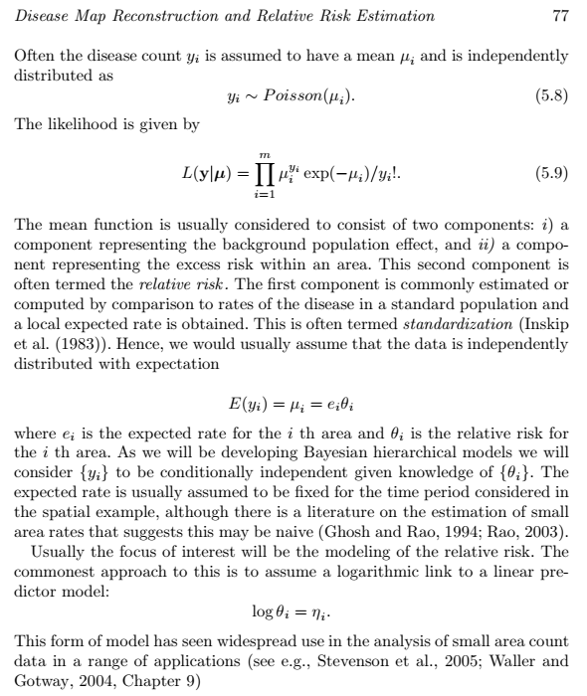
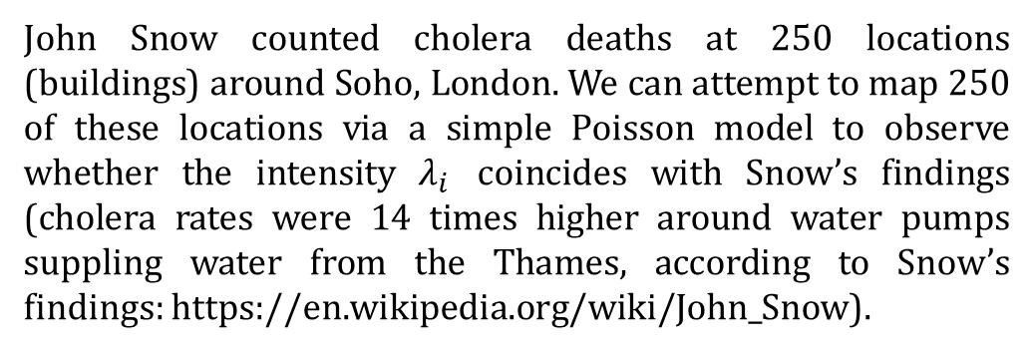
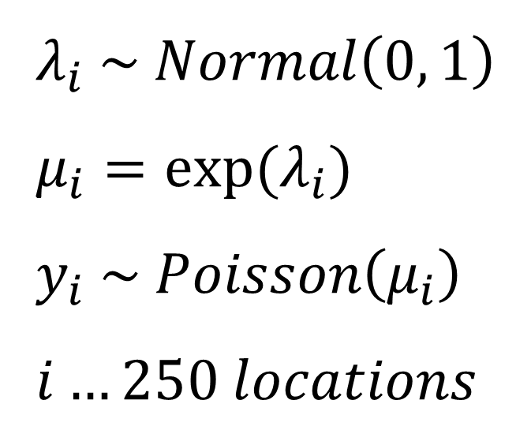
$$λ_{i} \sim Normal\left(0, 1\right) \\ μ_{i}=exp⁡(λ_{i}) \\ y_{i} \sim Poisson\left(μ_{i}\right) \\ i…250 locations$$
John Snow counted cholera deaths at 250 locations (buildings) around Soho, London. We can attempt to map 250 of these locations via a simple Poisson model to observe whether the intensity $λ_{i}$ coincides with Snow’s findings (cholera rates were 14 times higher around water pumps suppling water from the Thames, according to Snow’s findings: https://en.wikipedia.org/wiki/John_Snow).
From: Lawson, A. B. (2008). Bayesian Disease Mapping. CRC Press.

Slide 12
Once we have a model, we can attempt to take it through a Bayesian workflow. A Bayesian workflow is comprised of 5 important (but not necessarily sufficient) steps.
5 steps of a Bayesian Workflow:
Prior predictive checks
Convergence assessment
Posterior assessment
Posterior predictive checks
Model comparison

Slide 13
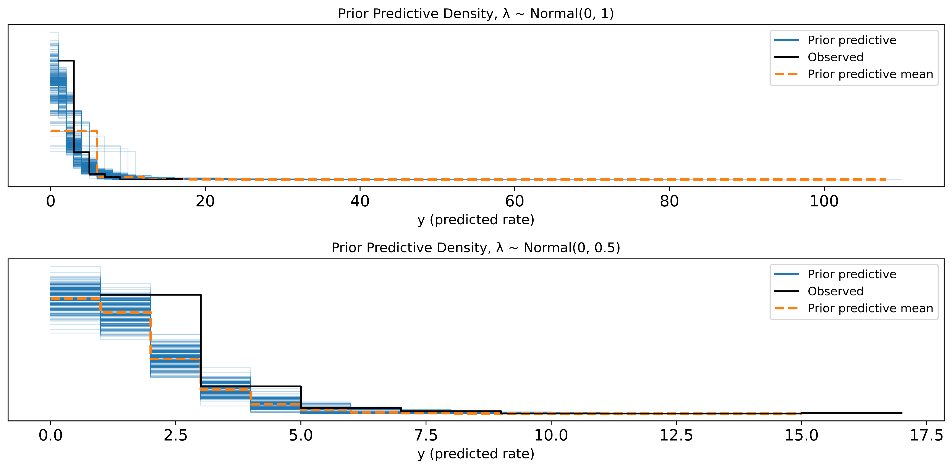
Prior predictive checks tell us that the initial simple model (Model 0) has good coverage but predicts exaggerated values (i.e over 100) at the tail. Another model (Model 1), with λ ~ Normal (0, 0.5), namely with half the standard deviation for the intensity parameter, tends to underpredict at the tails. Let’s compare them…

Slide 14
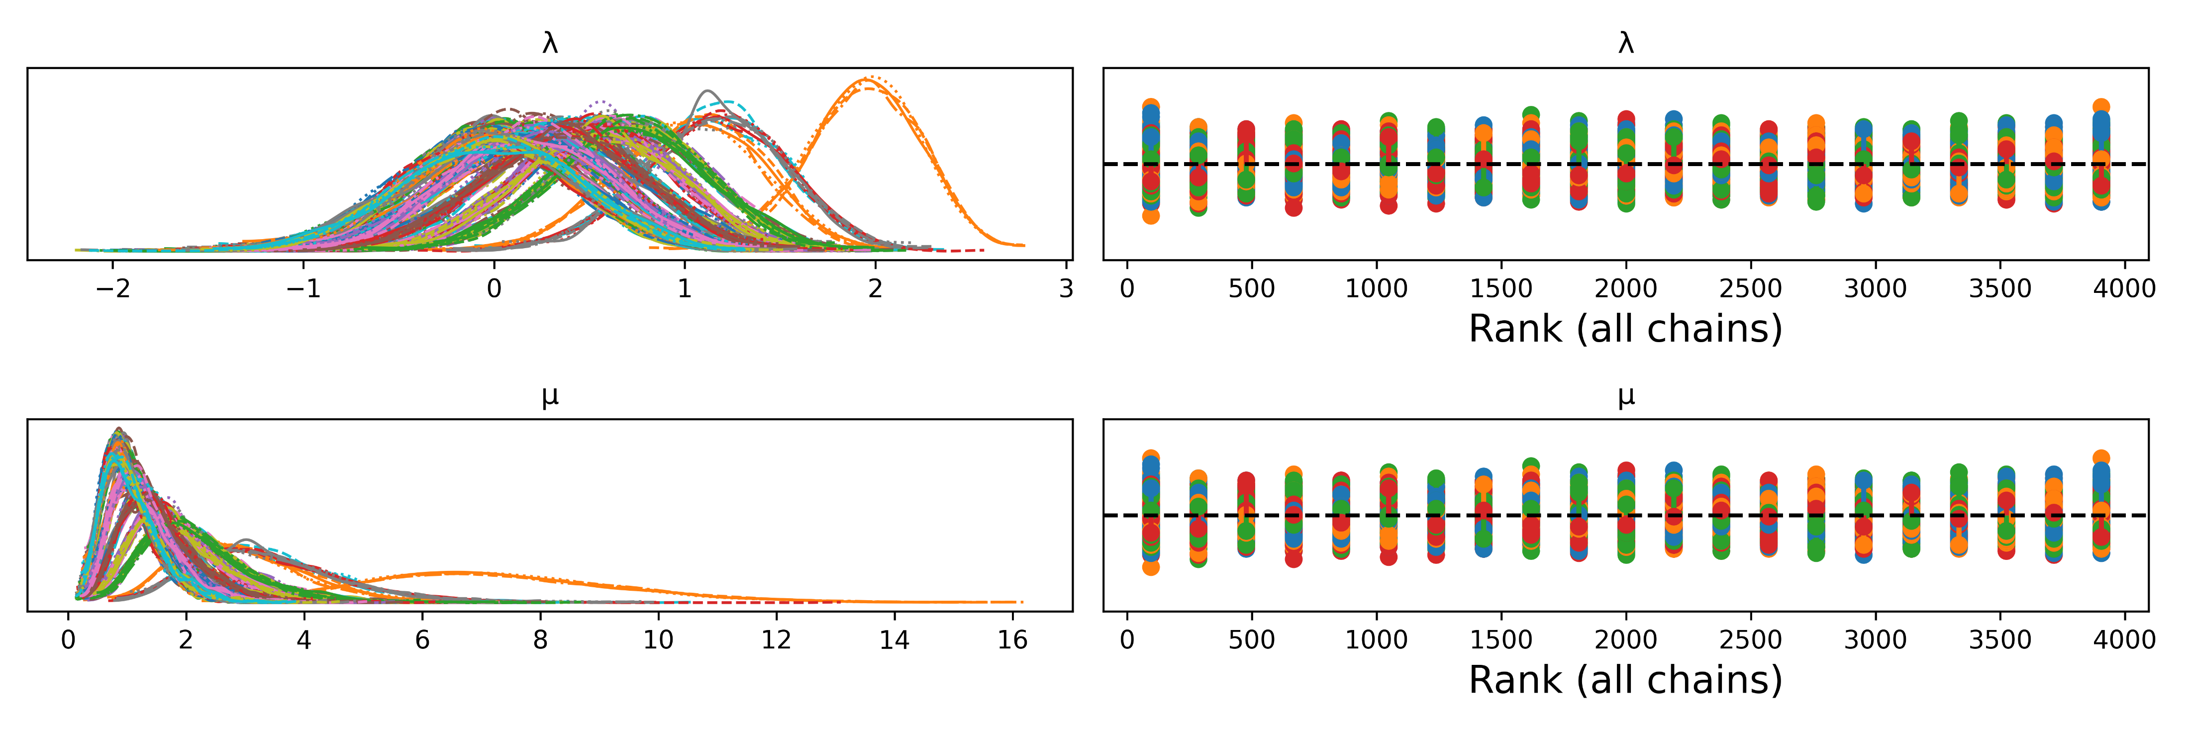
We sample the models with MCMC: 1000 tuning steps, 1000 steps, 4 chains. We assess convergence by checking that we have enough effective samples sizes (ESS) and that convergence statistics (R_hat) are between 1 and 1.01. In our case, we have over 5000 ESS and R_hats <= 1.01 for all parameters. We plot traces as rankplots to further confirm convergence. Example of rankplots from Model 1:

Slide 15
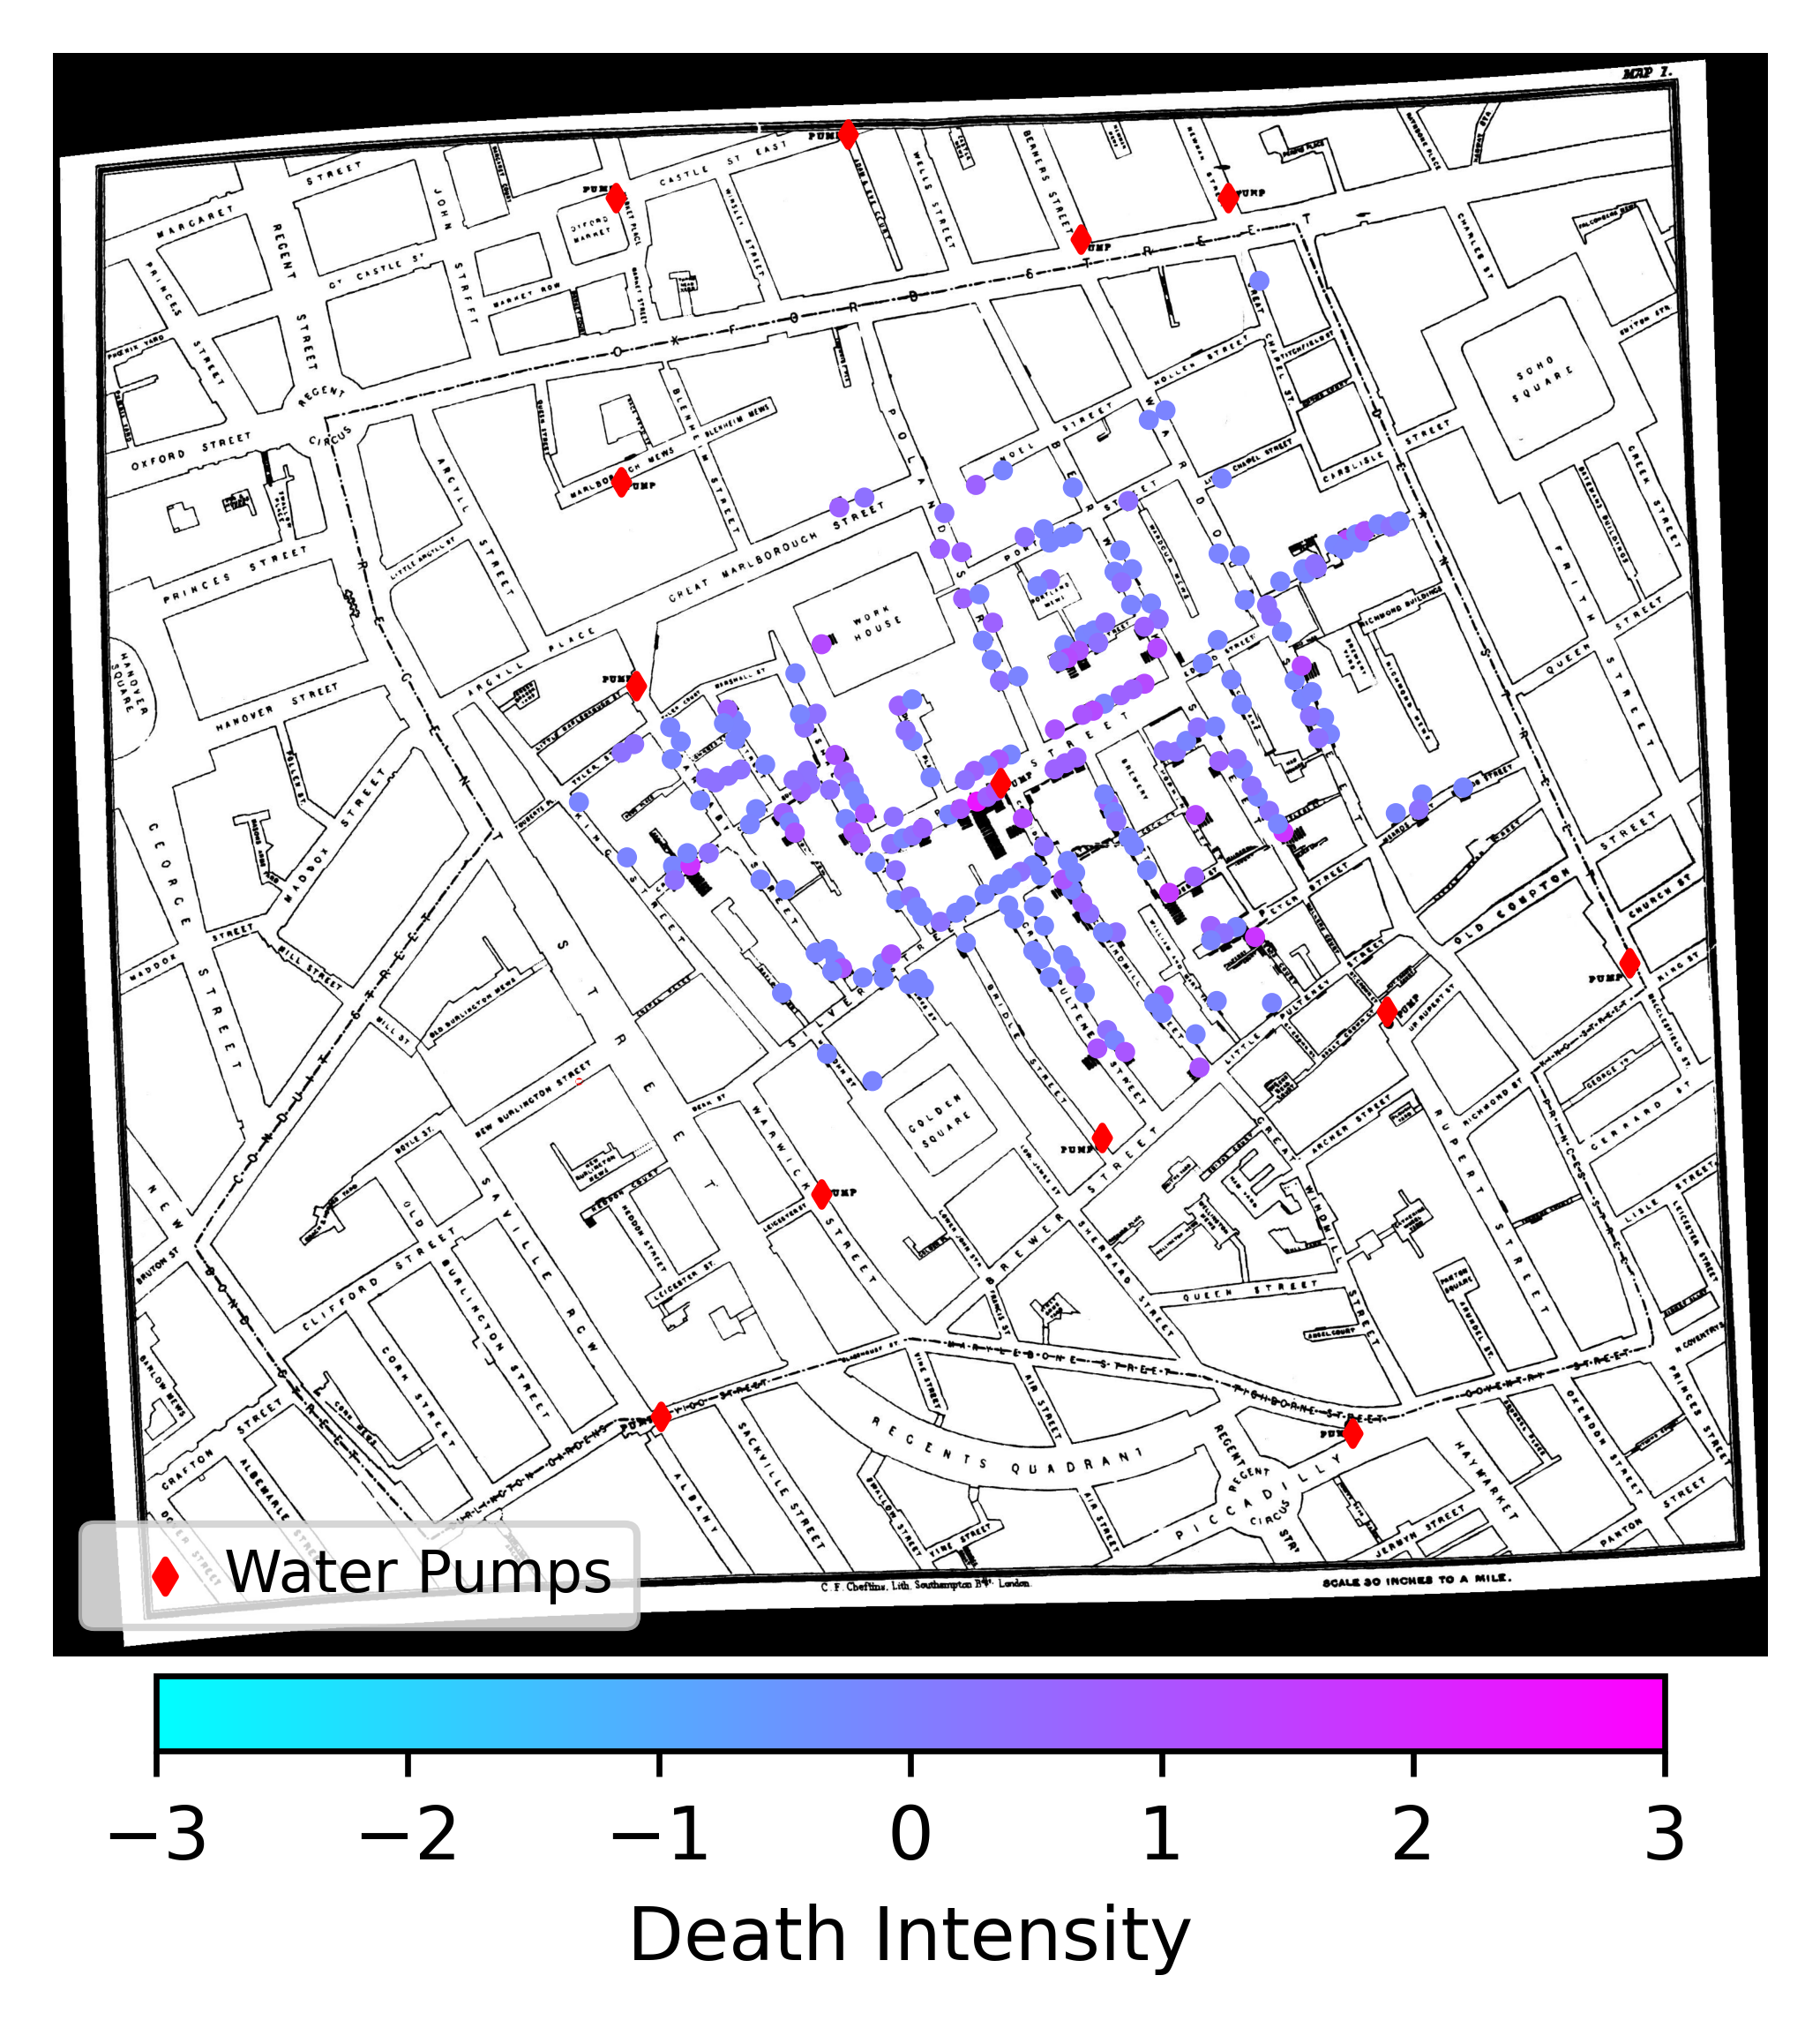
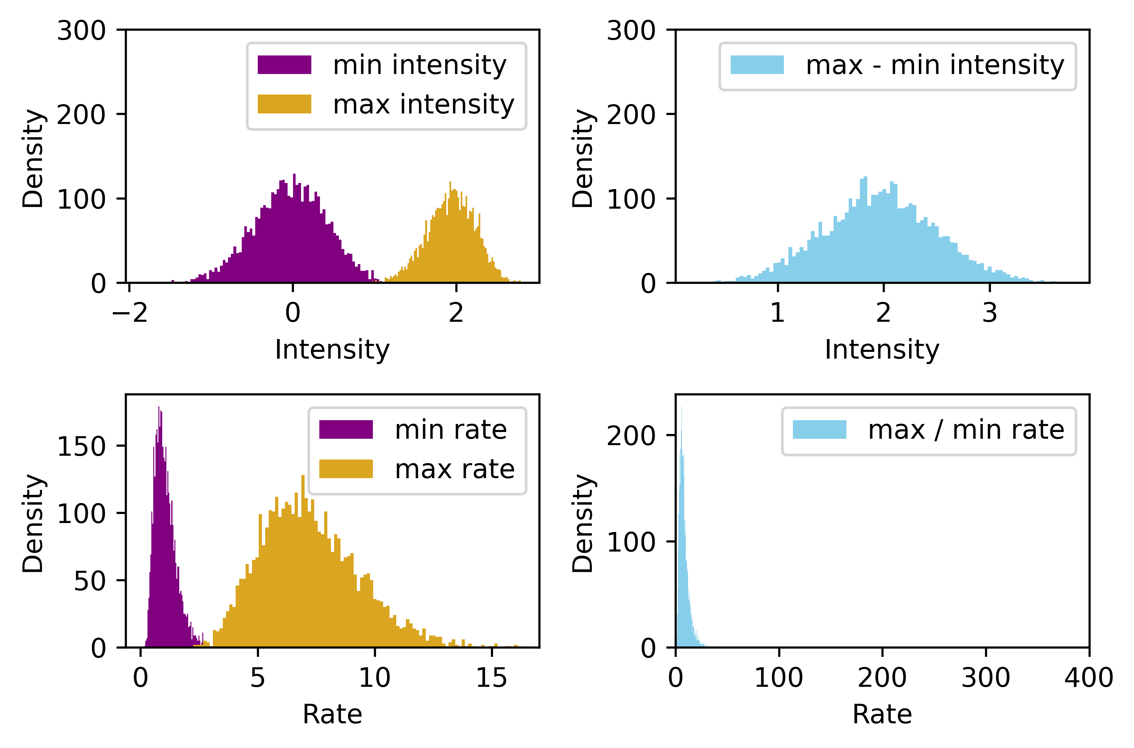
After MCMC sampling we can assess posterior distributions. From the above models we obtain a posterior distribution per location. Image at the left shows only posterior means from Model 1.
We should try to work with full posteriors. Image above shows posteriors from the locations with minimum and maximum intensities (Model 1).

Slide 16
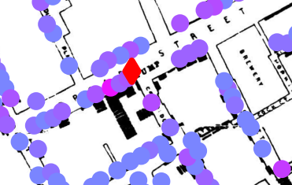

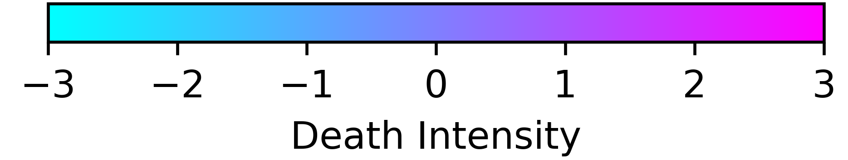
Maximum intensity (~2 ± 0.5) seems to be located around the infamous pump on Broad Street (as John Snow inferred).

Slide 17
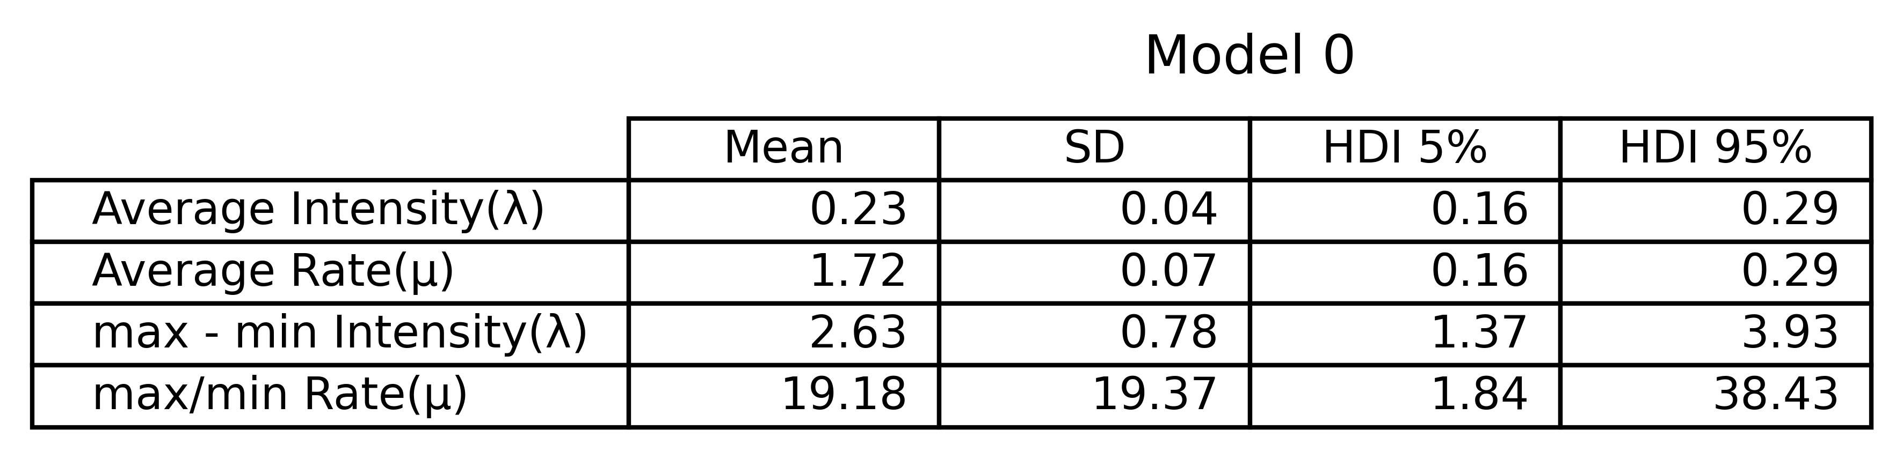
As expected from the prior predictive checks, the estimates of Model 0 inflate the maximum rate, while the estimates of Model 1 deflate it. Averaged mean max/min rates are ~13.5, aligned with John Snow’s findings. However, a proper model averaging would need to be performed to confirm that. Most importantly, this is not inference on the effect of cholera contaminated water pumps, but simply on the highest rate building vs the lowest rate one. The most we can do is to infer the average death rate on Soho, which is estimated to be ~1.7 ± 0.07 for Model 0 and ~ 1.3 ± 0.04 for Model 1.

Slide 18
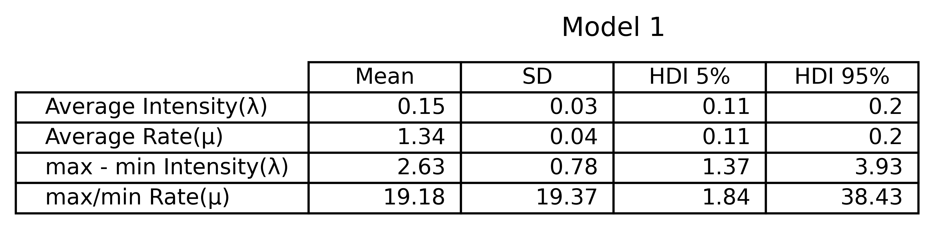
As expected from the prior predictive checks, the estimates of Model 0 inflate the maximum rate, while the estimates of Model 1 deflate it. Averaged mean max/min rates are ~13.5, aligned with John Snow’s findings. However, a proper model averaging would need to be performed to confirm that. Most importantly, this is not inference on the effect of cholera contaminated water pumps, but simply on the highest rate building vs the lowest rate one. The most we can do is to infer the average death rate on Soho, which is estimated to be ~1.7 ± 0.07 for Model 0 and ~ 1.3 ± 0.04 for Model 1.

Slide 19
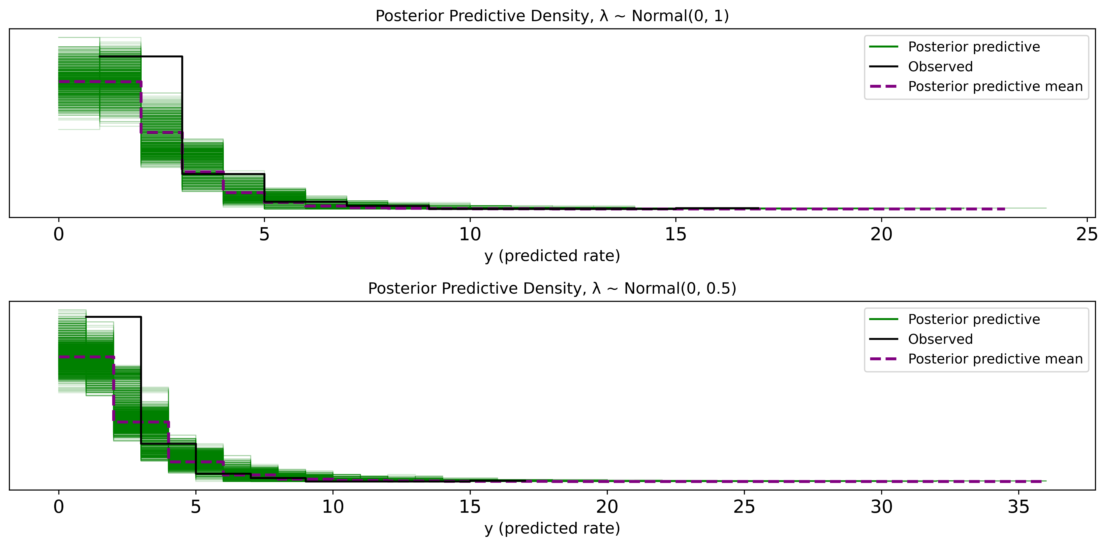
It is important to do posterior predictive checks, as they may tell a different story. Here we see that models have similar predictive capacity and that Model 0 is actually more constrained at the tails than Model 1, opposite to what we expected. This occurs because posterior predictive distributions accounts for the uncertainty of our parameters of interest (e.g. λ ).

Slide 20
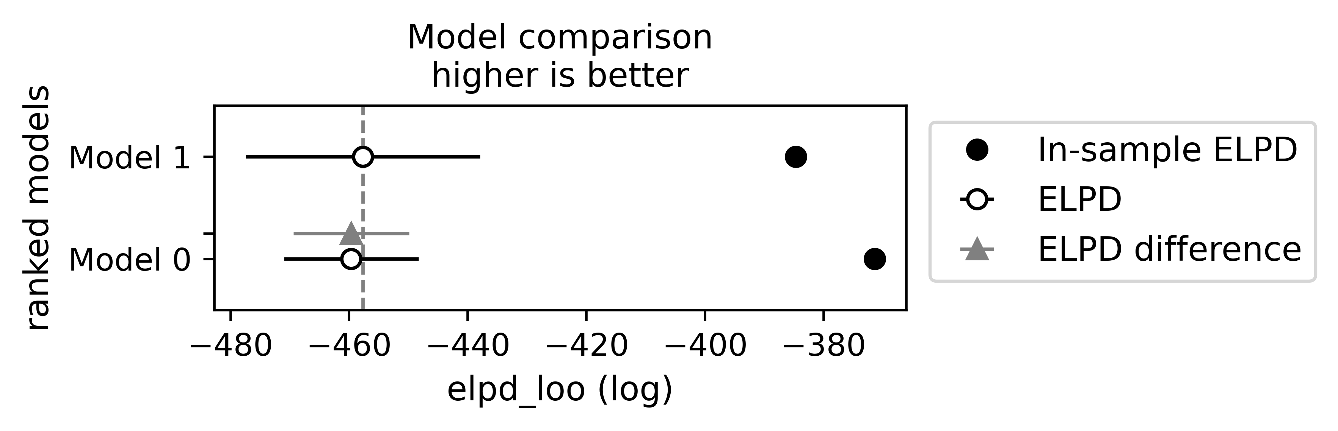
Indeed, a model comparison using Pareto-smoothed importance sampling leave one out cross validation (PSIS LOO-CV) shows that Model 1 outperforms Model 0 in terms of out-sample predictive capacity, but in-sample predictive capacity is better from Model 0.

Slide 21
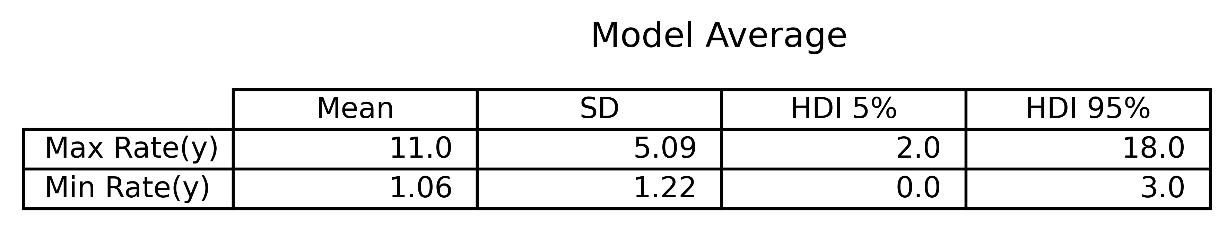
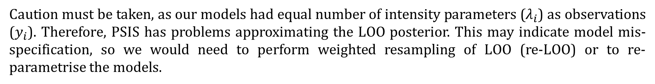
We perform model averaging, as an extension of model comparison, by taking the weighted posterior predictive distributions. This shows that the predicted maximum rate is ~11 times higher than the minimum rate (based on posterior predictive means only). Remember, this is not inference on the relationship between water pumps and cholera deaths, but simply on highest vs lowest rate buildings.
Caution must be taken, as our models had equal number of intensity parameters ($λ_{i}$) as observations ($y_{i}$). Therefore, PSIS has problems approximating the LOO posterior. This may indicate model mis-specification, so we would need to perform weighted resampling of LOO (re-LOO) or to re-parametrise the models.

Slide 22
In conclusion, though results show high uncertainty for some parameters, there is not much uncertainty overlap between high intensity and low intensity posteriors. We can say, with some confidence, that some locations (buildings) have much higher rates of cholera deaths.
However, these models do not incorporate information about water pumps. We could make an indirect inference about the water pump on Broad Street, but that is not sufficient for statistical inference.
Therefore, the present models can partially answer our research question, but they cannot support our hypothesis.
The next goal is to build up a model that can incorporate the locations of water pumps. There are many possible ways to do this, but we will attempt a relatively simple Poisson hierarchical regression in the next session.

Slide 23
Map images can be found at: https://github.com/epibayes/john-snow-data
Shapefiles can be found at: https://geodacenter.github.io/data-and-lab/snow/

